Slide 1

Reflection
SoftUni Team
Technical Trainers
Software University
http://softuni.bg

Slide 2
Table of Contents
What is Reflection?
Using Reflection
Assembly
System.Type
Emit IL code
Decompilation and Obfuscation
Roslyn
C# code compilation
Demo: Code Analyzer
Mono.Cecil

Slide 3

What is Reflection?

Slide 4

What is Reflection?
"Examine and modify the structure and behavior of the program at runtime"

Slide 5
When We Use Reflection?
Reflection is used when:
Examining assemblies metadata
Examine assemblies types
Dynamically invoking methods
Generate C# or IL code at runtime and execute it
Dynamically creating new assemblies, executing and storing them as a file
Inspecting an object at runtime without knowing its class

Slide 6
Drawbacks and Best Practices
What are the costs:
More code than normal coding
Slower than normal coding
The "golden hammer" principle
Leads to a lot of casting and type checking
Possible magic strings (for names)
When using Reflection:
First try not to use it
Try to cache all reflected metadata

Slide 7
Practical Reflection Steps
Dynamically Load Assemblies
Should be one time per assembly
Dynamically Load Types
Should be one time per type
Cast Types to a Known Interface/Base Type
All method calls go through the interface
No dynamic method calls – no Method.Invoke
Avoid interacting with private members
Usually balance between performance, safety and flexibility

Slide 8
Examples of Reflection Usage
Unit Tests Libraries and Mocking Libraries (xUnit, Moq)
Mapping Libraries (AutoMapper)
Dependency Containers
Plugin Systems (MEF, custom plugins)
Scripting Functionality (Razor View Engine)
ASP.NET Core (Controllers, Actions, Validation, Binding)
Code Analyzers (StyleCopAnalyzers)
LINQ-to-SQL
Serialization and Deep Cloning
Decompilers and Obfuscators

Slide 9

Loading Assemblies

Slide 10
Asembly.Load(…)
Loading via System.Reflection.Asembly.Load(…)
Takes as a parameter:
The name of the assembly
It searches for assemblies with the specified description and if it finds it loads it
If the assembly is not found it triggers a FileNotFoundException
Assembly.Load("ConsoleApp1");

Slide 11
Assembly.LoadFrom(...)
Loading via System.Reflection.Asembly.LoadFrom(…)
Takes the assembly path as a parameter
Reads the file specified
Invokes Load internally
Slower than Load(…)
If the assembly is not found, the FileNotFoundException is thrown
Assembly.LoadFrom(@"C:\Users\Repos\MyAssembly.dll");

Slide 12
Retrieve Assembly Information
FullName – the assembly's full name
Including version, culture and key (Public Key Token)
Location
Path from which the assembly was loaded
EntryPoint
The method by which the assembly will start (Main() method)
GlobalAssemblyCache
Boolean value indicating whether the assembly was loaded by GAC

Slide 13
Get Assemblies
Assembly.GetAssembly()
Gets the currently loaded assembly in which the specified type is defined
Assembly.GetEntryAssembly()
Gets the process executable in the default application domain
In other application domains, this is the first executable that was executed
Assembly.GetCallingAssembly()
Returns the Assembly of the method that invoked the currently executing method
GetExecutingAssembly()
Gets the Assembly that contains the code that is currently executing

Slide 14
Assemblies
Demo

Slide 15
What is GAC?

Slide 16
What is Global Assembly Cache?
It is the central repository for shared assemblies available for use with .NET Framework applications
They have a uniquely names that identifies them
Don't add assemblies to the GAC unless necessary
Location: C:\Windows\assembly
.NET Core 2.0+ has Runtime package store
.NET Core also has 2 types of deployment:
Framework-dependent deployment
Self-contained deployment (libraries and runtime)

Slide 17
System.Type

Slide 18
System.Type
Primary way to access metadata
Obtained at compile time, if you can specify the type:
Can be obtained at runtime, if you know the name:
Provides access to all type members:
Fields, Methods, Properties, Events, Inner types…
Type myType = typeof(ClassName);
Type myType = Type.GetType("Namespace.ClassName");

Slide 19
Properties of System.Type
FullName - Fully qualified class name
Name - Class name without the namespace
BaseType
Boolean properties
IsAbstract, IsArray, IsByRef, IsClass, IsEnum, IsInterface, IsPublic, IsSealed, IsValueType, IsPointer, IsPrimitive, …
string fullName = typeof(SomeClass).FullName;
string simpleName = typeof(SomeClass).Name;
Type baseType = typeof(SomeClass).BaseType;

Slide 20
Get Methods of System.Type
GetField("fieldName");
GetMethod("methodName");
GetProperty("propName");
GetConstructor(typeof());
GetInterface("intfName");
GetCustomAttribute(typeof(ObsoleteAttribute));
GetMember();
GetFields();
GetMethods();
GetProperties();
GetConstructors();
GetInterfaces();
GetCustomAttributes();
GetMembers();

Slide 21
BindingFlags
BindingFlags.Public
Returns all public members
Default enumeration
BindingFlags.NonPublic
Returns all private, protected and internal methods
BindingFlags.Instance
Returns all methods which are non-static
BindingFlags.Static
Returns all static methods

Slide 22
System.Type
Demo

Slide 23
Instances and Invocations

Slide 24
Instance of Class
Gets the desired constructor
Invoke the constructor with desired objects
Invoked method returns the instance
Or just simply call the static class Activator
var type = typeof(Person);
var ctor = type.GetConstructor(new[] { typeof(string) });
var instance = ctor.Invoke(new object[] { "Pesho" });
var instance = Activator.CreateInstance(typeof(Person),"Pesho");

Slide 25
Method Invocation Steps
Create instance of the class
Get the desired method
Call the invoke method
var instance = Activator.CreateInstance(typeof(Person),"Pesho");
var calculateDateMethod = typeof(Person).GetMethod("CalculateDate", BindingFlags.NonPublic | BindingFlags.Instance);
var calculateDateMethodResult = calculateDateMethod.Invoke(instance, null);
var eatMethod = typeof(Person).GetMethod("Eat");
var eatMethodResult = eatMethod.Invoke(instance, new object[] { "Burger" });

Slide 26
Instances and Invocations
Demo

Slide 27
Generics
MakeGenericType
MakeGenericMethod
Type genericList = typeof(List<>);
Type[] genericArguments = { typeof(string) };
Type result = genericList.MakeGenericType(genericArguments);
static void Main(string[] args) {
var type = typeof(Program);
var myGenericMethodInfo = type.GetMethod("MyGenericMethod");
var makeGenericMethod =
myGenericMethodInfo.MakeGenericMethod(typeof(int));
}
public void MyGenericMethod<T>() {}

Slide 28
Generics
Demo

Slide 29
Reflection Emit

Slide 30
What is Reflection Emit?
Create entire assemblies runtime with IL
Save assembly to disk
Execution of assembly
Assembly and preservation of assemblies
Allows us to create assemblies from scratch
Modules
Types
Fields, Methods, Events, Properties

Slide 31
Reflection Emit
Emit provides a set of classes for creating assembly parts
Assemblies - AssemblyBuilder
Modules - ModuleBuilder
Types - TypeBuilder
Constructors - ConstructorBuilder
Methods - MethodBuilder
Properties - PropertyBuilder
Events - EventBuilder

Slide 32
Using of Reflection Emit
MSIL instructions are generated through Emit class
They represent MSIL executable code
They can be added to a method
Emit(…) - we add in a stream a sequence of MSIL instructions
EmitWriteLine(…) - Adds instructions for printing a string
Creating executable assemblies:
AssemblyBuilder.SetEntryPoint(…)

Slide 33
Reflection Emit
Demo

Slide 34
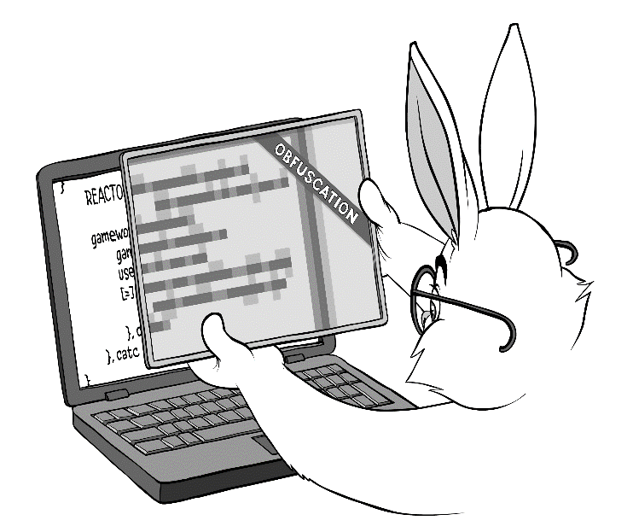
Decompilation and Obfuscation

Slide 35
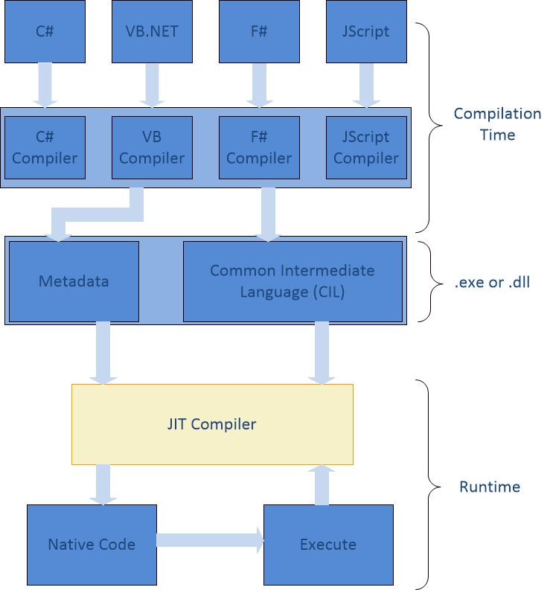
Compilation
We write the code in human- readable text format (C# files)
.NET compilers compile it into intermediate lang. (C# + CSC = CIL)
Upon execution IL instructions are converted to machine instructions (JIT + CIL = native)
Just-In-Time (JIT)
Ahead of time (AOT) (NGEN)

Slide 36
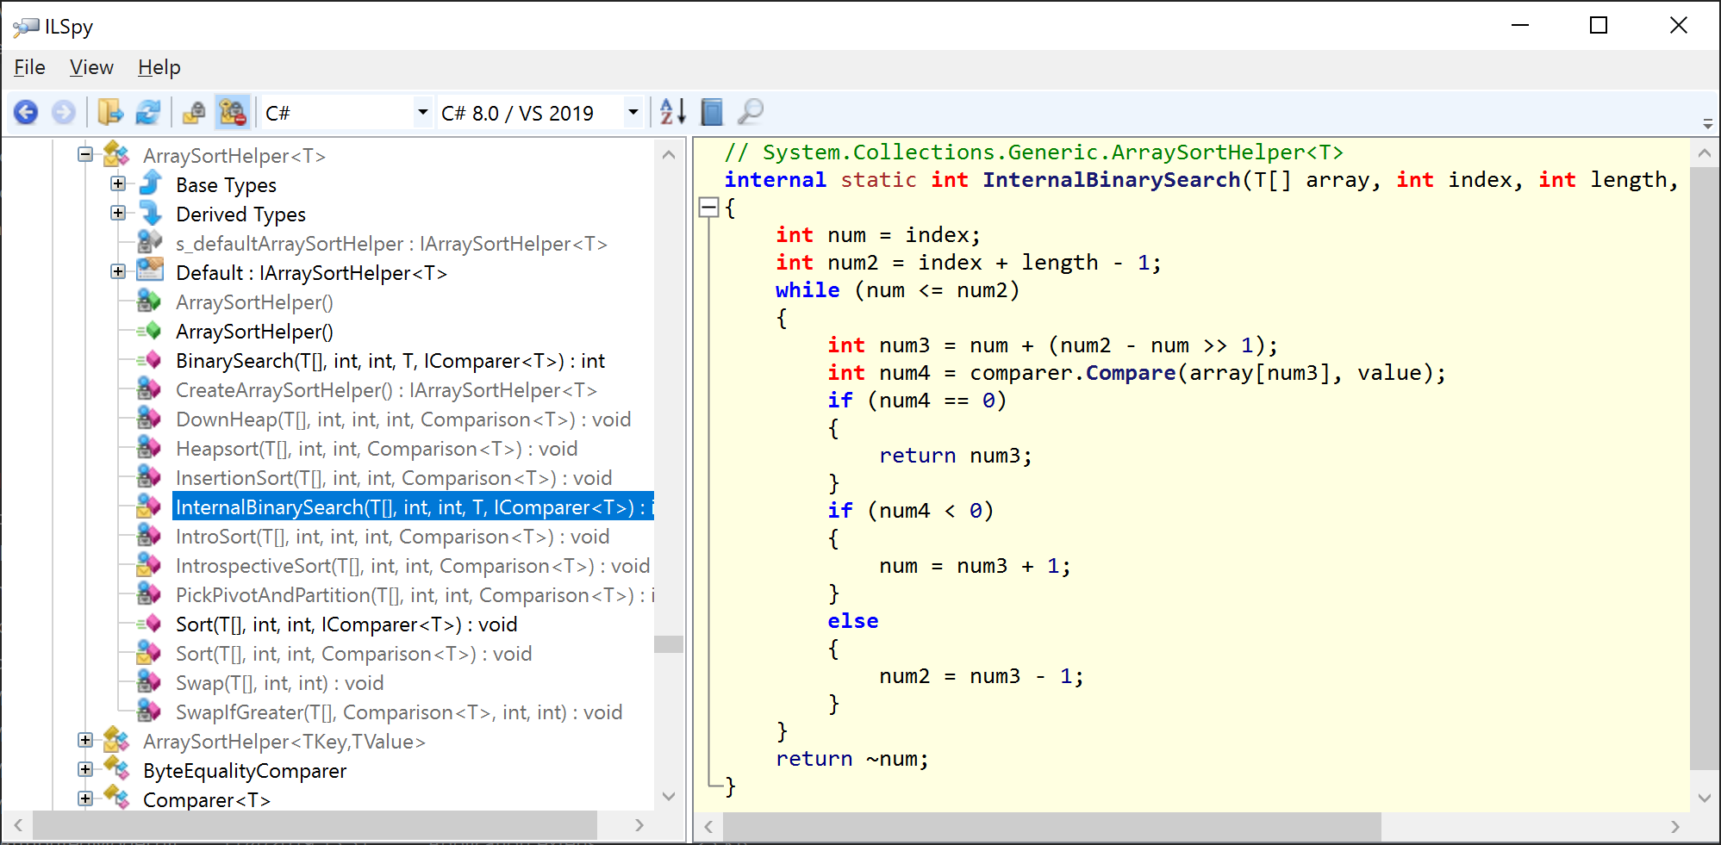
Decompilation
A decompiler takes an executable file as input, and attempts to create a high level source file which can be recompiled
Decompilation is the exact opposite of the compilation step
.NET .dll/.exe -> C#
Popular decompilers: ILSpy, dnSpy, dotPeek, JustDecompile, IL DASM

Slide 37
Obfuscation
A way to make decompiled code less readable
Private variables, fields and parameters renames to "nonsense" or unprintable names
Techniques that breaks decompilers but the IL code is still valid
Public member names remain unchanged
Similar to JavaScript minification
Ultimately, this is an ongoing battle between the obfuscators and the decompilers

Slide 38
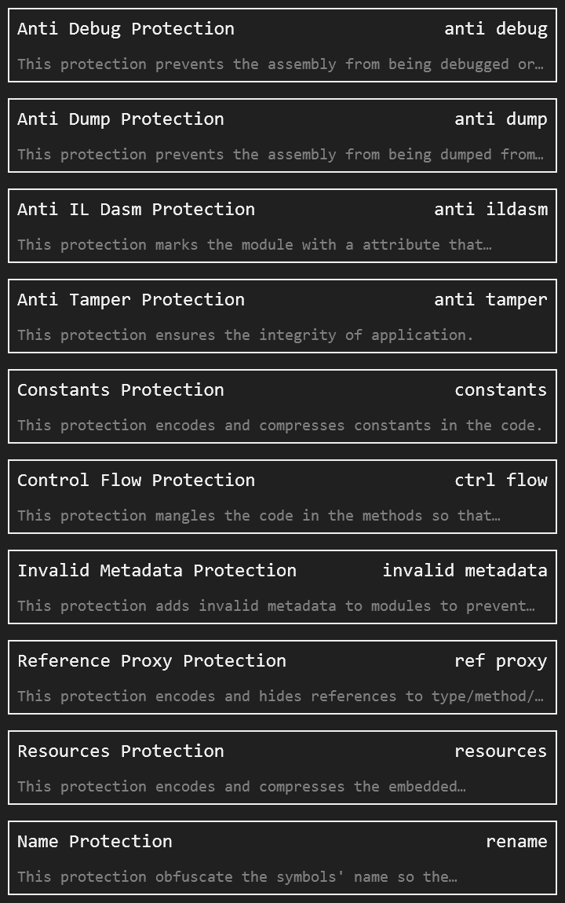
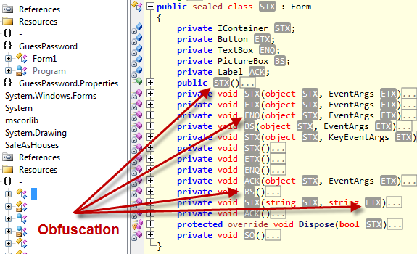
Obfuscators for .NET
https://github.com/yck1509/ConfuserEx [discontinued]
https://github.com/mkaring/ConfuserEx [.NET Core]
https://github.com/XenocodeRCE/neo-ConfuserEx
https://www.obfuscar.com/ [.NET Core, No UI]

Slide 39

Roslyn Overview
Open Source .NET Compiler Platform

Slide 40
Roslyn (.NET Compiler Platform)
It exposes a set of Compiler APIs and Workspaces APIs that provides rich information about your source code
https://github.com/dotnet/roslyn
It creates many opportunities for innovation
Meta-programming
Code generation and transformation
Interactive use of the C# and VB languages
Embedding of C# and VB in domain specific languages
Create code analyzers

Slide 41
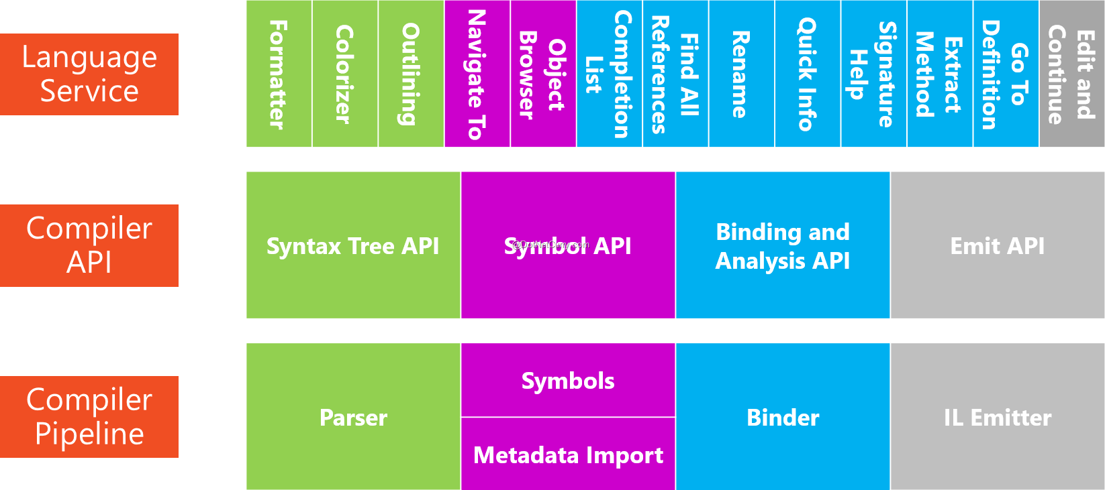
Compiler Pipeline
Parser phase – Source is tokenized and parsed into syntax that follows the language grammar
Declaration phase – Declarations from the source and imported metadata are analyzed to form named symbols
Bind phase - Identifiers in the code are matched to symbols
Emit phase - All the information built up by the compiler is emitted as an assembly

Slide 42

Custom View Engine
Demo

Slide 43
Code Analyzer
Live Demo

Slide 44
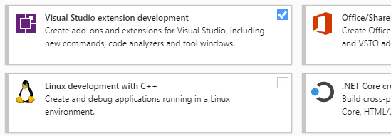
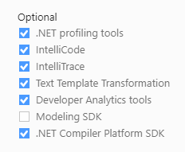
Code Analyzer – Installation Steps
Open "Get Tools and Features…" from the VS menu
Check the Visual Studio extension development workload
Check the box for .NET Compiler Platform SDK
You'll find it last under the optional components

Slide 45
Code Analyzer – Creation Steps
Create new project of type
C# Analyzer with code fix
Name – MakeConst
Open Resources.resx and rename the values
AnalyzerTitle - Variable can be made constant
AnalyzerDescription - Make Constant
AnalyzerMessageFormat - can be made constant
Change the const string Category to Usage

Slide 46
Code Analyzer – Creation Steps (2)
Open MakeConstAnalyzer and replace Initialize method
public override void Initialize(AnalysisContext context)
{
var analyze = GeneratedCodeAnalysisFlags.Analyze;
var none = GeneratedCodeAnalysisFlags.None;
var localDeclartions = SyntaxKind.LocalDeclarationStatement;
context.ConfigureGeneratedCodeAnalysis(analyze | none);
context.EnableConcurrentExecution();
context
.RegisterSyntaxNodeAction(AnalyzeNode, localDeclartions);
}

Slide 47
AnalyzeNode Method
private void AnalyzeNode(SyntaxNodeAnalysisContext context)
{
var localDeclaration = (LocalDeclarationStatementSyntax)
context.Node;
if (localDeclaration.Modifiers.Any(SyntaxKind.ConstKeyword))
{
return;
}
var dataFlowAnalysis = context.SemanticModel.AnalyzeDataFlow(localDeclaration);
...

Slide 48
AnalyzeNode Method (2)
var variable = localDeclaration.Declaration.Variables.Single();
var variableSymbol = context.SemanticModel.GetDeclaredSymbol
(variable);
if (dataFlowAnalysis.WrittenOutside.Contains(variableSymbol))
{
return;
}
context.ReportDiagnostic(Diagnostic.Create(Rule, context.Node
.GetLocation()));
}

Slide 49
The Mono.Cecil Library

Slide 50
The Mono.Cecil Library
Library written to generate and inspect programs and libraries in the ECMA CIL format
Analyze .NET binaries using a simple and powerful object model without having to load assemblies to use Reflection
Cecil has support for extracting the CIL bytecodes
Modify .NET binaries, add new metadata structures and alter the IL code
Usages: ILSpy, ConfuserEx, Mono Linker (Blazor, Xamarin)
https://github.com/jbevain/cecil

Slide 51
The Mono.Cecil Library
Demo

Slide 52

Summary
…
…
…
Examining assemblies metadata
Dynamically creating assemblies
Decompilation and Obfuscation
Roslyn
Custom View Engine
Code Analyzer
Mono.Cecil

Slide 53
https://softuni.bg/courses/csharp-oop-basics

Slide 54












SoftUni Diamond Partners

Slide 55




SoftUni Organizational Partners

Slide 56




Trainings @ Software University (SoftUni)
Software University – High-Quality Education and Employment Opportunities
softuni.bg
Software University Foundation
http://softuni.foundation/
Software University @ Facebook
facebook.com/SoftwareUniversity
Software University Forums
forum.softuni.bg

Slide 57

License
This course (slides, examples, demos, videos, homework, etc.) is licensed under the "Creative Commons Attribution-NonCommercial-ShareAlike 4.0 International" license

